Slide 1
The stock return–inﬂation puzzle revisited
- Liam A. Gallagher , Mark P. Taylor

Slide 2
Puzzle?
Fishers model (1930)
- nominal asset returns move one on one with inflation
Correlation Observed in post war data for US
Negative : inflation and real stock returns
Hence the name “stock return – inflation” puzzle

Slide 3
Data
Inflation, CPI
GDP
Real stock price index (deflated by CPI)
Range used in paper : 1957Q1 through 1997Q4
Range used in replication: 1951Q1 through 2019Q3

Slide 4

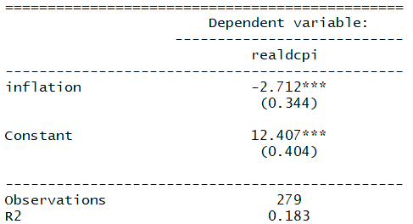
Regressing stock returns on inflation
Paper results
Replication results

Slide 5

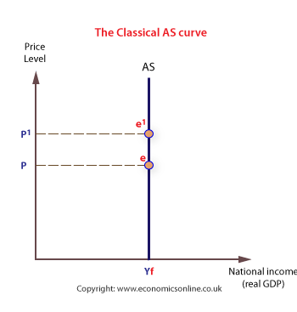
Fama (1981)
‘Proxy hypothesis’
Supply shocks – effects the output more
Only Inflation due to supply as proxy
Fama’s hypothesis predicts only the supply component is significant and negatively correlated with stock returns

Slide 6
Intuition behind
Stock prices current + expected future dividends real output
Demand shocks just temporary effects real output
expected future dividends real stock returns small
Though there is short run effect of demand shocks on stock returns
uncorrelated with any inflation movements
Negative correlations (inflation and real stock returns)
largely due to inflationary supply side shocks

Slide 7
Blanchard and Quah(1989)
Econometric technique to isolate permanent and temporary shocks using Vector Auto regressive systems(multivariate decomposition)
Permanent – supply shocks
Temporary – demand shocks
Where y = Gdp (output)
p = inflation

Slide 8
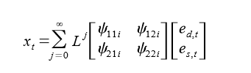
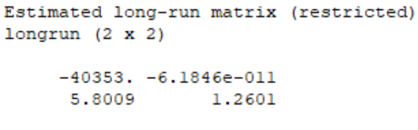
Multivariate decomposition
represents the parameters of multivariate moving average representation
Where e_{d,t} –represents demand innovations
e_{s,t} – represents supply innovations
By imposing restrictions on the coefficients in the equation, we can identify inflation due to demand and supply shocks

Slide 9
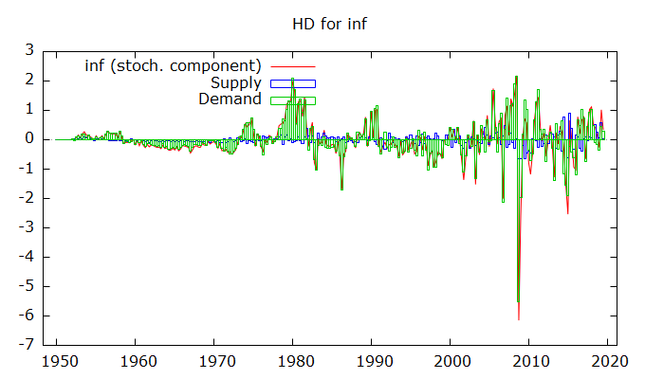

Slide 10

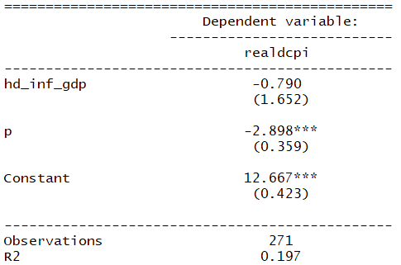
Paper Results:
Replication results

Slide 11
Long Horizon test
Boudoukh and Richardson (1993) found stronger empirical support to the hypothesis when longer horizon is considered.
We investigate the data for the annual frequency to check the robustness of the results

Slide 12
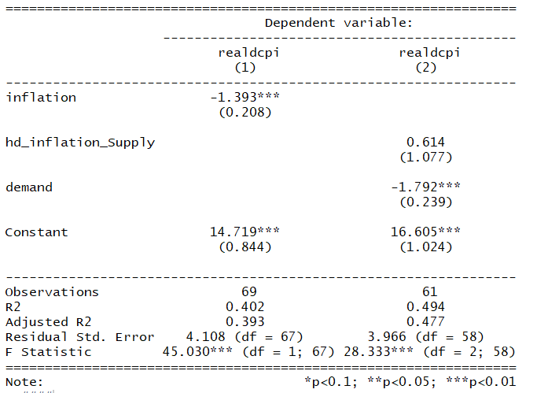
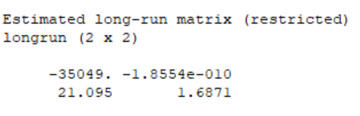
Separate Var estimated for
annual data

Slide 13
Decomposition graph for annual data

Slide 14
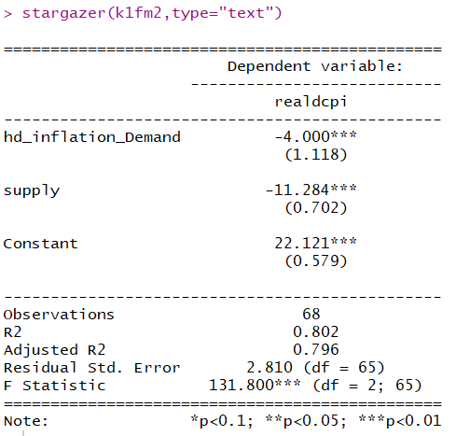
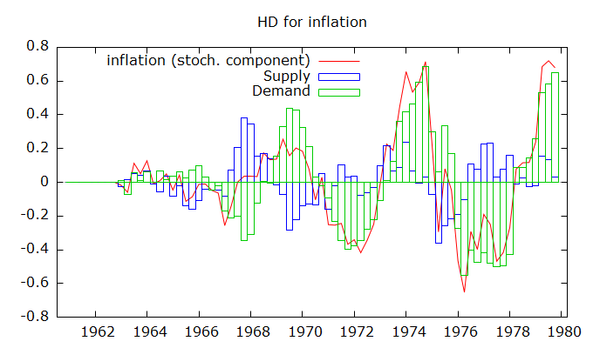

Kaul’s Hypothesis (Interest rate regime 1961Q1 to 1979Q4)

Slide 15
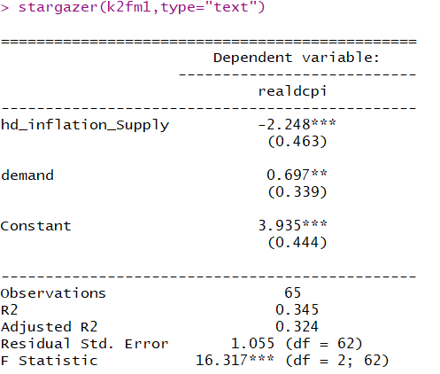
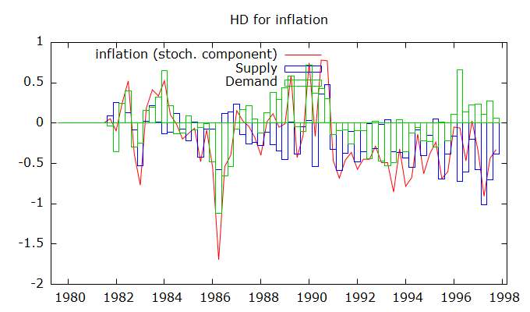

Kaul’s hypothesis (Money supply regime 1979 to 1997)

Slide 16
Conclusion
US real stock returns vs Inflation vs Real output growth
Real stock returns were found to be
Insignificantly correlated – inflation due to demand innovations
Significantly negatively correlated – inflation due to Supply innovations
The results are robust to varying data frequency and sub periods

